Slide 1

'Liveability' - the qualities of a place (city, town, suburb, neighbourhood) that contribute to the quality of life experienced by residents and others.

Slide 2
Most & Least ‘Liveable’ Cities
Least Liveable Cities 2017
Least Liveable Cities
top 10 most liveable cities 2017

Slide 3
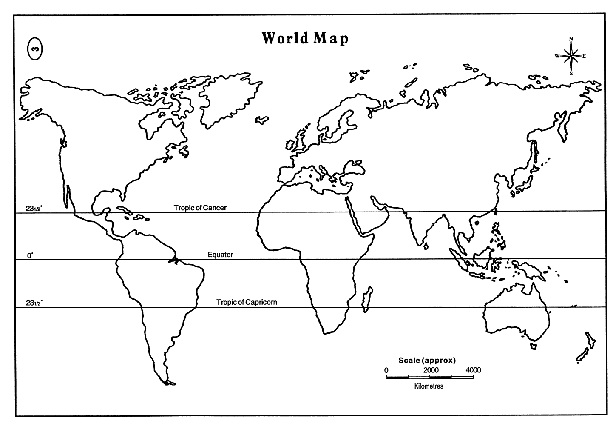

Mapping the
Most & Least ‘Liveable’ Cities

Slide 4

Bangladesh
Legend
Melbourne
Liveable
Unliveable
‘Liveability’

